Slide 1

E-Voting System
Using C++
C++ Console-Based Project
COURSE NAME: Object Oriented Programming Using C++
COURSE CODE: CSE 202

Slide 2
What is an E-Voting System?
Electronic voting uses computers to record, store, and count votes. It reduces manual effort, speeds up results, and makes election data easier to organize. Our project demonstrates these ideas through a focused C++ console application.
> voter.login()
> ballot.cast()
> result.count()
DIGITAL BALLOT

Slide 3
From manual delays to digital control
Traditional voting
Project objectives
Manual counting
Slow result preparation
Higher risk of counting errors
Authenticate voters
Enforce one person, one vote
Count accurately
Generate results quickly

Slide 4
Users and core features
ADMIN
CANDIDATE
Login • election setup
Candidate management
E-VOTING
SYSTEM
Profile and ballot listing
VOTER
RESULTS
Registration • secure login
Cast one vote
Count • save • display

Slide 5
C++ concepts that power the project
01 Classes & Objects
02 Encapsulation
03 Inheritance
Organize voter, candidate, and election data
Protect internal state and rules
Reuse shared user behavior
04 Exceptions
05 STL
06 File Handling
Handle invalid input safely
Vector, Map, and Set storage
Persist votes and results

Slide 6
Project file structure
include/
Header declarations
src/
Class implementations
data/
Votes and election info
main.cpp
Program entry point
CMakeLists.txt + Makefile
Build configuration

Slide 7
Security by design — within project scope
SECURE
VOTE
✓ Admin and voter authentication
✓ Duplicate-vote prevention
✓ Open / close election checks
✓ Secret-ballot approach
✓ Audit logging for stored data
EDUCATIONAL PROTOTYPE — NOT FOR REAL PUBLIC ELECTIONS

Slide 8
Advantages — and honest limitations
ADVANTAGES
LIMITATIONS
✓ Faster vote counting
✓ Organized voter and candidate management
✓ Less paperwork
✓ Simple local-file storage
× Console interface only
× No online voting
× Local files, not a database
× Not suitable for real elections

Slide 9
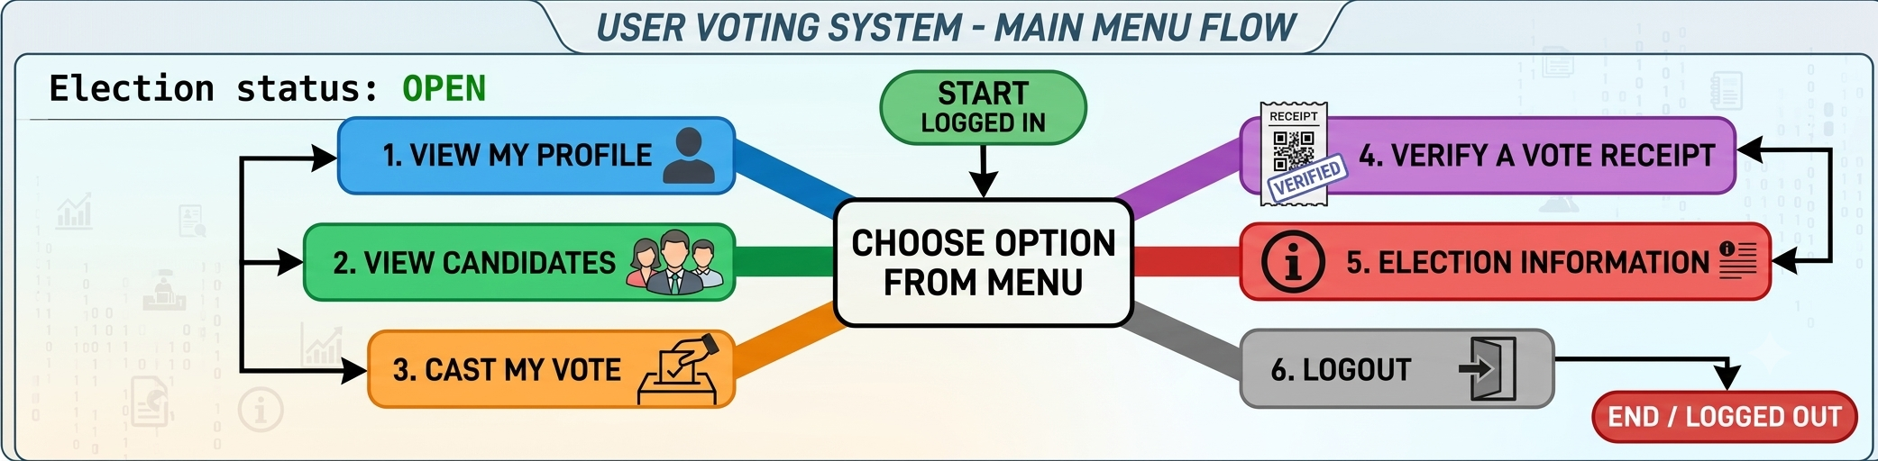
FLOWCHART

Slide 10
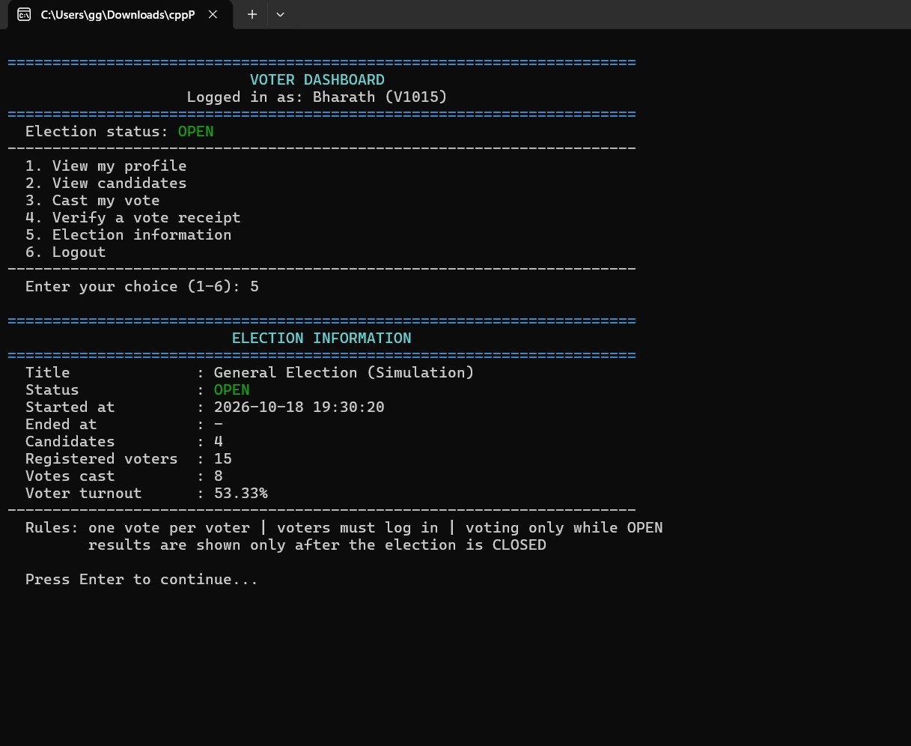
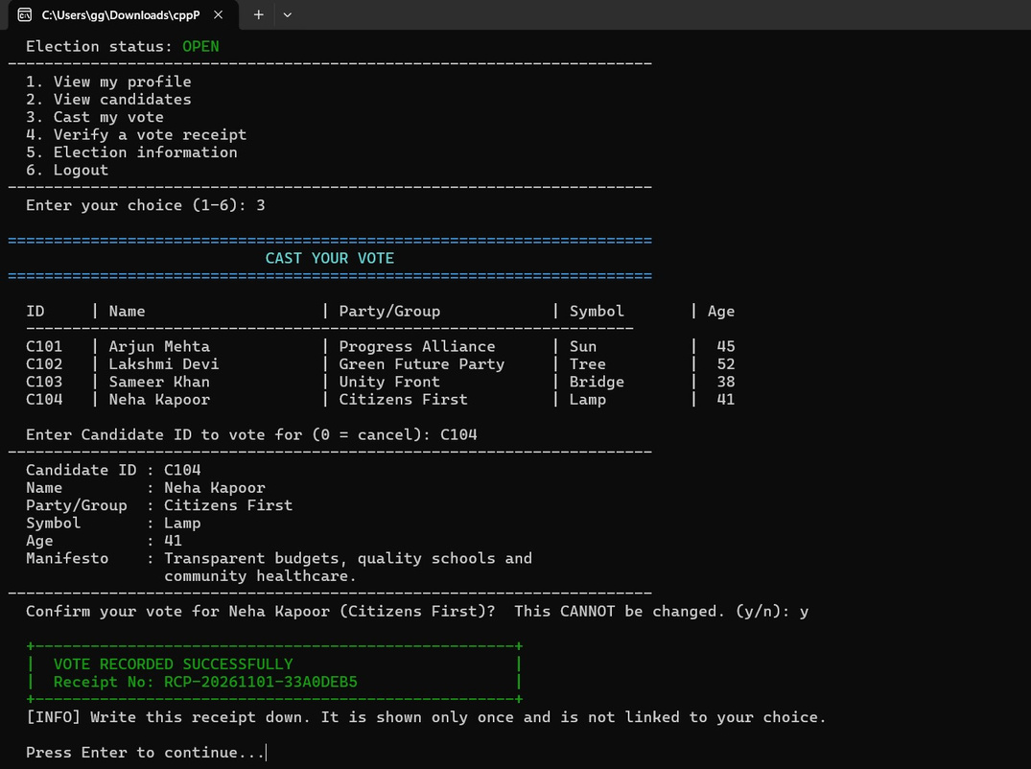
Test the journey, not just the code

Slide 11
Concusion
Our E-Voting System is a simple console-based application developed using C++. It provides an organized way to manage voters, candidates, and election activities.
Through this project, we implemented important C++ concepts such as Object-Oriented Programming, inheritance, polymorphism, file handling, and exception handling.
The system helps to:
  Simplify the voting process.
  Prevent duplicate voting.
  Maintain voter and candidate information.
  Store votes and generate election results.
  Improve our practical programming skills.
Overall, this project helped us understand how C++ concepts can be used to develop a real-world inspired application.

Slide 12
THANK YOU
Questions & Answers
A C++ e-voting prototype that brings together authentication, structured data handling, vote integrity, and fast result generation — built to learn, test, and improve.
Presented by Member 3

